Slide 1


Erasmus Smart Port Rotterdam
René de Koster
Rotterdam School of Management
Research program: 2011-2014

Slide 2
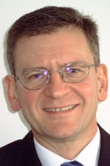


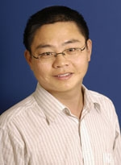
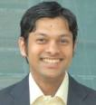
The team
René de Koster (prof. Logistics)
Amir Gharehgozli (PhD candidate)
Nima Zaerpour (PhD candidate)
Yugang Yu (Ass. Professor)
Debjit Roy (Postdoc as from 1-8-’11)
And others (Stam, Balk, Dul, Larco,..)

Slide 3
Research topics
Container terminal operations
Compact storage
The “Human factor”
New topics: Ultimate, green operations

Slide 4
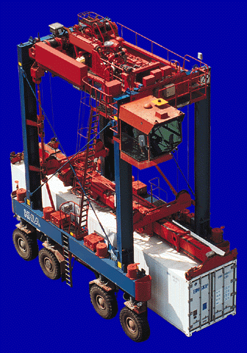
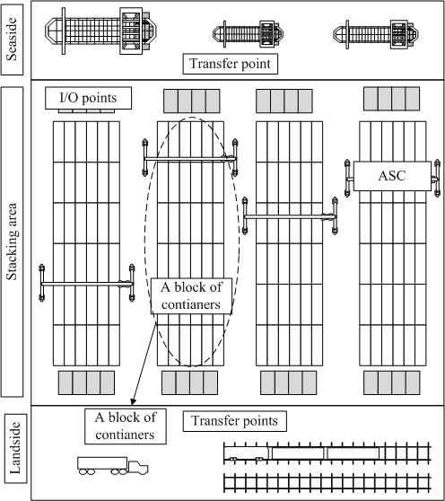
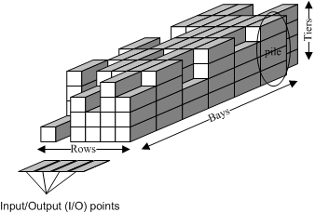
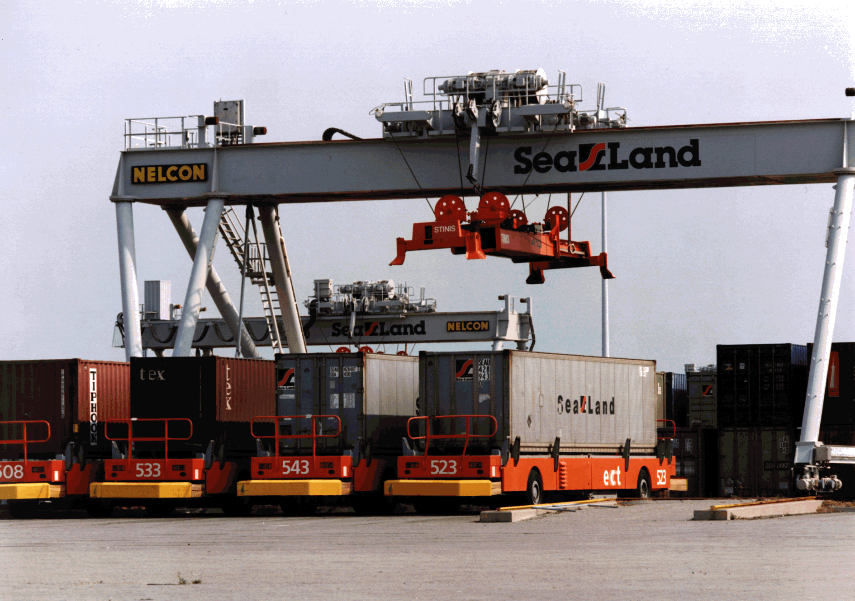
1. Container terminal operations

Slide 5
1. Container terminal operations
Yu, Gharehgozli: stacking
Objectives: minimizing makespan, response time,..
Where to store containers?
In which sequence to retrieve containers?
How to layout stacks?
Method: mathematical programming models
Roy: transport, scheduling
Objectives: estimating performance of a container terminal as function of the design, the handling systems, and policies
Method: queuing network models

Slide 6
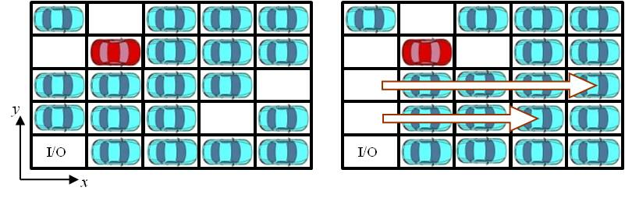
2. Compact storage

Slide 7
2. Compact storage
Zaerpour
Objectives: minimizing makespan, response time, efficient design, ..
How to determine performance for different types of storage systems?
Where to store loads?
How to retrieve loads
Method: modeling

Slide 8
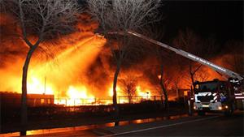
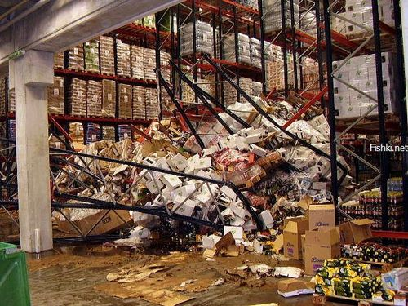

3. The human factor

Slide 9
3. The human factor
Larco
Questions:
how to stimulate people to become more productive (and happy)?
How to include human factor objectives into operational decisions
Method: experimenting, modeling
Balk, Stam
Questions:
How to reduce the number of accidents in warehouses?
Which traits make managers successful in reducing accidents?
Method: surveys

Slide 10
Output 2011-2012
Container terminals:
No published output yet. 2 working papers (target journals: TRB, TS)
Compact storage:
No published output yet. 2 working papers (target journal: TS)
The human factor:
One accepted paper: JOM
one working paper (IIE T)

